Slide 1
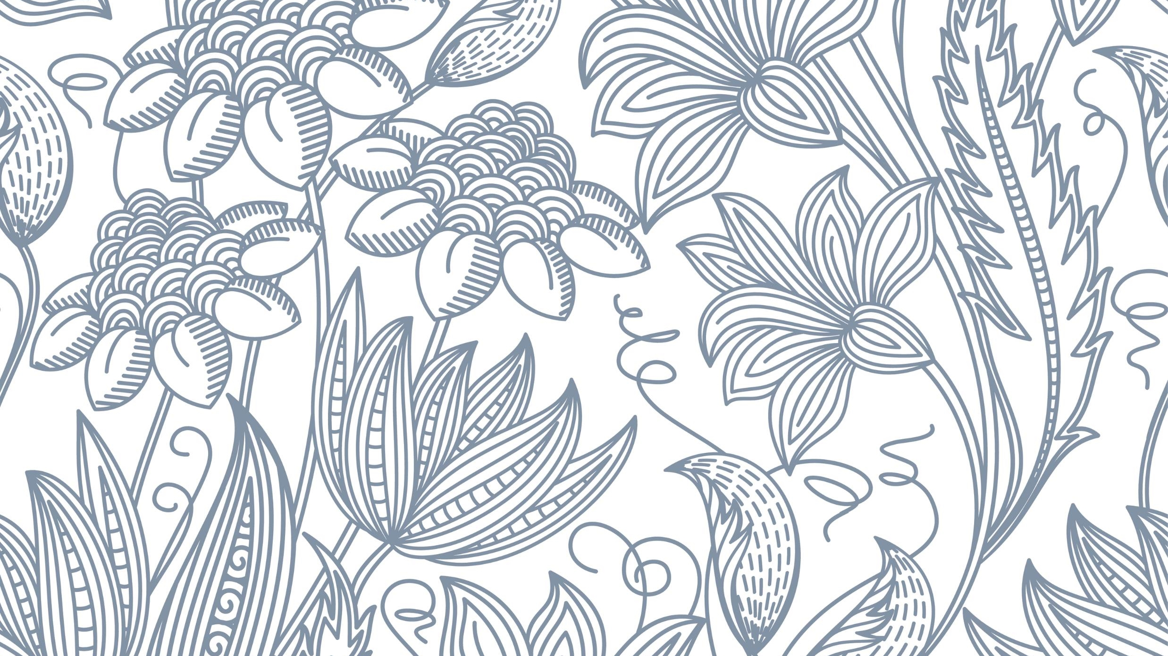
WELCOME
~ Divyansh Jha

Slide 2
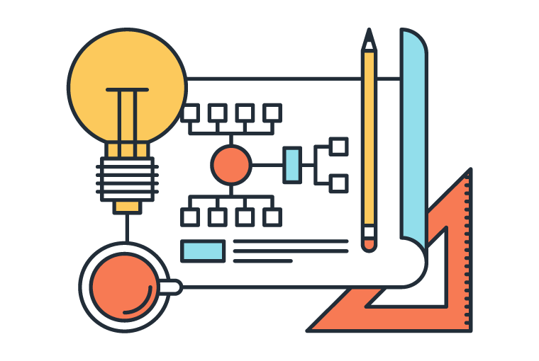
Uses of Queue

Slide 3
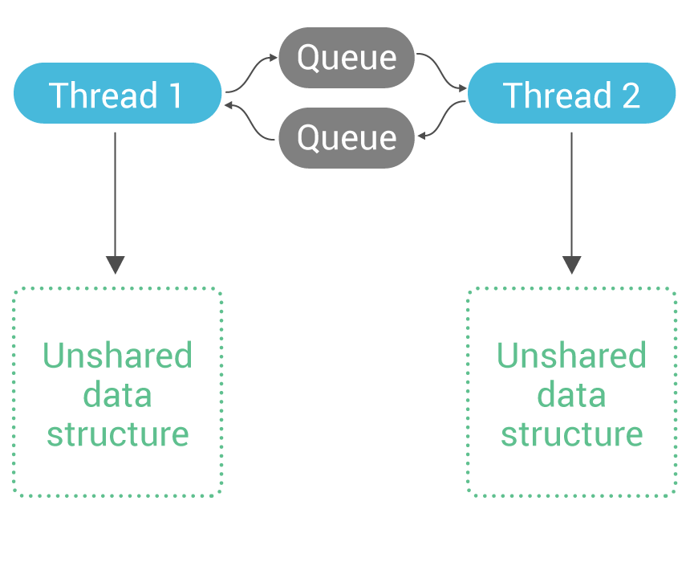
What are Queues?
Data Structure
Linear Data Structure
Stores Data in Sequential Order
FIFO – First In First Out

Slide 4

What are the uses of Queues?
Real life examples:-
Lines at a ticket counter
People standing on an escalator.
Both are examples of First In First Out mechanism.

Slide 5

Applications in Computer Science
Working of a printer
Priority queues for an operating system
Keyboard entries under load
Spotify and other music platforms have music playlists
Handling of CPU scheduling
Handling website traffic
etc

Slide 6

Conclusion
Queues are a linear Data Structure
Queues work on a First In First Out principle (FIFO)
Queues have a wide range of applications
Queues are very important in our daily lives
Queues are very important for computer science and its applications

Slide 7

The End!

